Slide 1
CS209: Computer Science II

Slide 2
Unit 2 Module 4:
Stacks and Queues
Introduction to the Stack
Dynamic Stacks
Introduction to the Queue
Dynamic Queues

Slide 3
Introduction to the Stack ADT
Stack: a LIFO (last in, first out) data structure
Examples:
plates in a cafeteria
return addresses for function calls
Implementation:
static: fixed size, implemented as array
dynamic: variable size, implemented as linked list

Slide 4
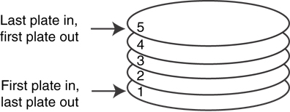
A LIFO Structure

Slide 5
Stack Operations and Functions
Operations:
push: add a value onto the top of the stack
pop: remove a value from the top of the stack
Functions:
isFull: true if the stack is currently full, i.e., has no more space to hold additional elements
isEmpty: true if the stack currently contains no elements

Slide 6
Stack Operations - Example
A stack that can hold char values:
E
K
E
G
K
E
push('E');
push('K');
push('G');

Slide 7
Stack Operations - Example
A stack that can hold char values:
E
K
E
pop();
(remove G)
pop();
(remove K)
pop();
(remove E)

Slide 8
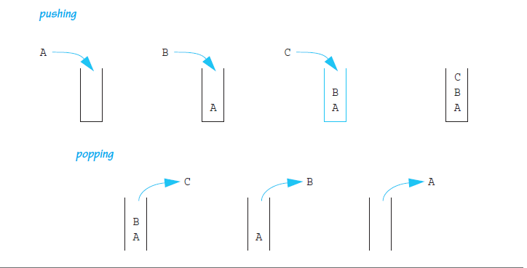
Stack Operations - Example

Slide 9
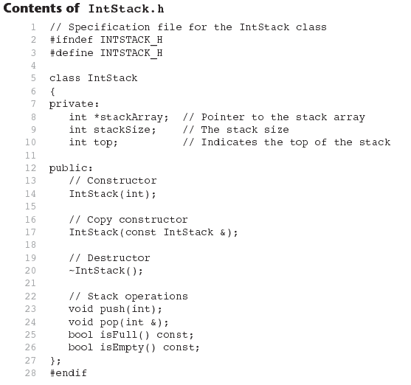

Slide 10
#include <iostream>
#include "IntStack.h"
using namespace std;
//***********************************************
// Constructor *
// This constructor creates an empty stack. The *
// size parameter is the size of the stack. *
//***********************************************
IntStack::IntStack(int size)
{
stackArray = new int[size];
stackSize = size;
top = -1;
}

Slide 11
IntStack::IntStack(const IntStack &obj)
{
// Create the stack array.
if (obj.stackSize > 0)
stackArray = new int[obj.stackSize];
else
stackArray = nullptr;
// Copy the stackSize attribute.
stackSize = obj.stackSize;
// Copy the stack contents.
for (int count = 0; count < stackSize; count++)
stackArray[count] = obj.stackArray[count];
// Set the top of the stack.
top = obj.top;
}

Slide 12
// Destructor
IntStack::~IntStack()
{
delete [] stackArray;
}
// Member function push pushes the argument onto
// the stack.
void IntStack::push(int num)
{
if (isFull())
{
cout << "The stack is full.\n";
}
else
{
top++;
stackArray[top] = num;
}
}

Slide 13
// Member function pop pops the value at the top
// of the stack off, and copies it into the variable
// passed as an argument.
void IntStack::pop(int &num)
{
if (isEmpty())
{
cout << "The stack is empty.\n";
}
else
{
num = stackArray[top];
top--;
}
}

Slide 14
// Member function isFull returns true if the stack
// is full, or false otherwise.
bool IntStack::isFull() const
{
bool status;
if (top == stackSize - 1)
status = true;
else
status = false;
return status;
}

Slide 15
// Member funciton isEmpty returns true if the stack
// is empty, or false otherwise.
bool IntStack::isEmpty() const
{
bool status;
if (top == -1)
status = true;
else
status = false;
return status;
}

Slide 16
Dynamic Stacks
Grow and shrink as necessary
Can't ever be full as long as memory is available
Implemented as a linked list

Slide 17
Implementing a Stack
Programmers can program their own routines to implement stack functions
See DynIntStack class in the book for an example.
Can also use the implementation of stack available in the STL

Slide 18
class DynIntStack
{
private:
// Structure for stack nodes
struct StackNode
{
int value; // Value in the node
StackNode *next; // Pointer to the next node
};
StackNode *top; // Pointer to the stack top
public:
DynIntStack()
{ top = nullptr; }
~DynIntStack();
void push(int);
void pop(int &);
bool isEmpty();
};

Slide 19
#include <iostream>
#include "DynIntStack.h"
using namespace std;
DynIntStack::~DynIntStack()
{
StackNode *nodePtr = nullptr, *nextNode = nullptr;
// Position nodePtr at the top of the stack.
nodePtr = top;
// Traverse the list deleting each node.
while (nodePtr != nullptr)
{
nextNode = nodePtr->next;
delete nodePtr;
nodePtr = nextNode;
}
}

Slide 20
void DynIntStack::push(int num)
{
StackNode *newNode = nullptr; // Pointer to a new node
// Allocate a new node and store num there.
newNode = new StackNode;
newNode->value = num;
// If there are no nodes in the list
// make newNode the first node.
if (isEmpty())
{
top = newNode;
newNode->next = nullptr;
}
else // Otherwise, insert NewNode before top.
{
newNode->next = top;
top = newNode;
}
}

Slide 21
void DynIntStack::pop(int &num)
{
StackNode *temp = nullptr; // Temporary pointer
if (isEmpty())
{
cout << "The stack is empty.\n";
}
else // pop value off top of stack
{
num = top->value;
temp = top->next;
delete top;
top = temp;
}
}

Slide 22
bool DynIntStack::isEmpty()
{
bool status;
if (!top)
status = true;
else
status = false;
return status;
}

Slide 23
Introduction to the Queue ADT
FIFO: First in, First Out
Restricted form of list: Insert at one end, remove from the other.
Notation:
Insert: Enqueue
Delete: Dequeue
First element: Front
Last element: Rear

Slide 24
Introduction to the Queue ADT
Queue: a FIFO (first in, first out) data structure.
Examples:
people in line at the theatre box office
print jobs sent to a printer
Implementation:
static: fixed size, implemented as array
dynamic: variable size, implemented as linked list

Slide 25
Queue Locations and Operations
rear: position where elements are added
front: position from which elements are removed
enqueue: add an element to the rear of the queue
dequeue: remove an element from the front of a queue

Slide 26
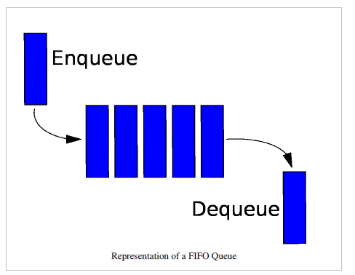
Queue Enqueue and Dequeue

Slide 27
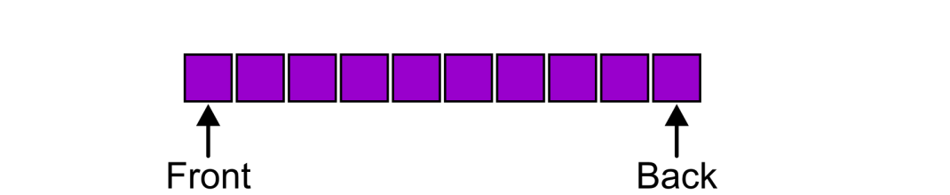
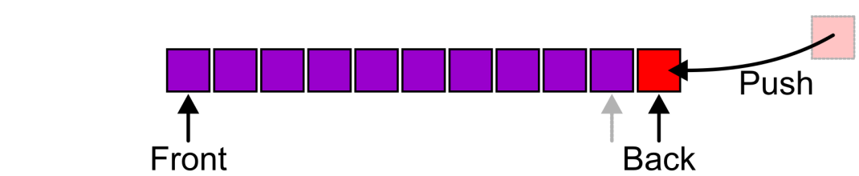
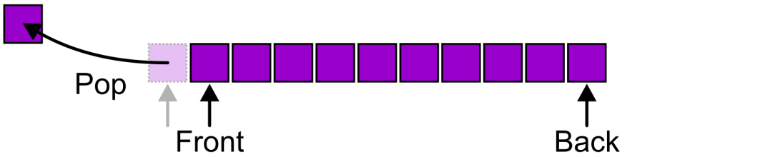
Queue – FIFO data structure
Also called a first-in–first-out (FIFO) data structure
Graphically, we may view these operations as follows:

Slide 28
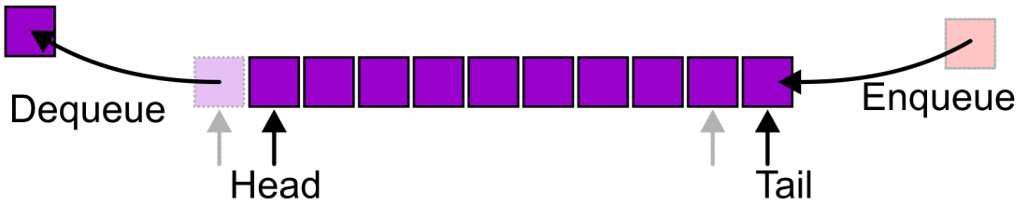
Queue – four operations
Alternative terms may be used for the four operations
on a queue, including:

Slide 29
Queue Operations - Example
A currently empty queue that can hold char values:
enqueue('E');
front
E
rear

Slide 30
Queue Operations - Example
enqueue('K');
enqueue('G');
front
E | K
rear
front
E | K | G
rear

Slide 31
Queue Operations - Example
dequeue(); // remove E
dequeue(); // remove K
front
K | G
rear
front
G
rear

Slide 32
dequeue Issue, Solutions
When removing an element from a queue, remaining elements must shift to front
Solutions:
Let front index move as elements are removed (works as long as rear index is not at end of array)
Use above solution, and also let rear index "wrap around" to front of array, treating array as circular instead of linear (more complex enqueue, dequeue code)

Slide 33
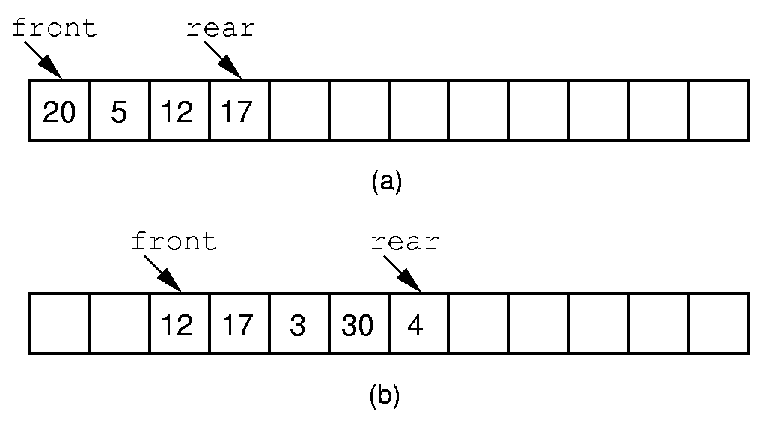
Queue Implementation

Slide 34
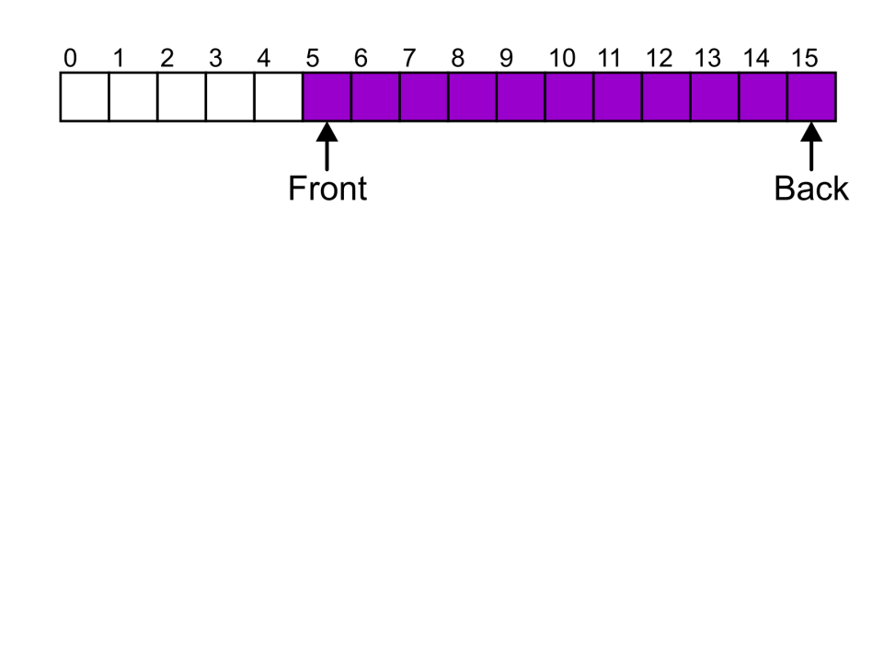
Queue Implementation
Suppose that:
The array capacity is 16
We have performed 16 pushes
We have performed 5 pops
The queue size is now 11
We perform one further push
In this case, the array is not full and yet we cannot place any more objects in to the array

Slide 35
Circular Arrays
Drifting queue: use a circular array to insert and remove items from a queue in constant time, O(1)
The idea of a circular array is that the end of the array “wraps around” to the start of the array
7
0
6
1
5
2
4
3

Slide 36
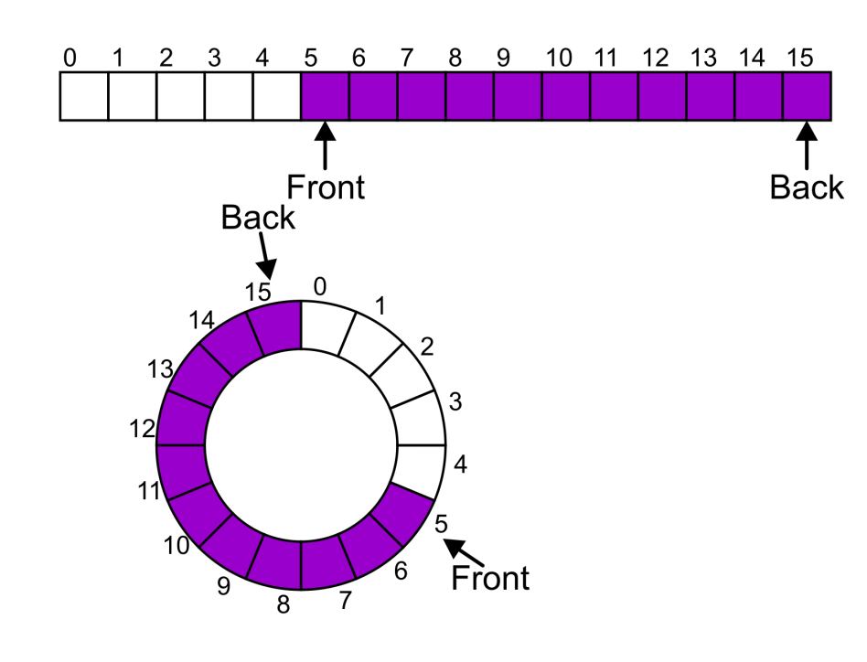
Circular Arrays
Instead of viewing the array on the range 0, …, 15, consider the indices being cyclic:
…, 15, 0, 1, …, 15, 0, 1, …, 15, 0, 1, …
Notes:
36

Slide 37
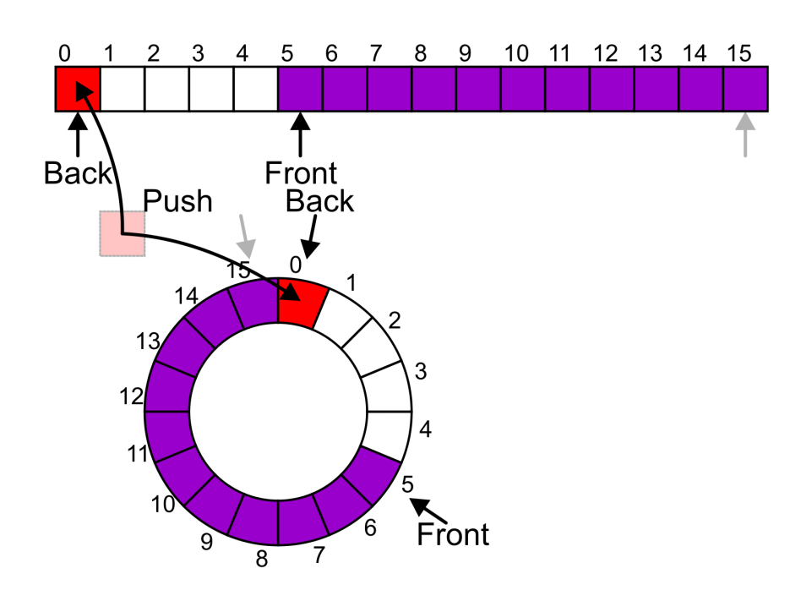
Circular Arrays
Now, the next push may be performed in the next available location of the circular array:
++iback;
if (iback == capacity())
{
iback = 0;
}
Notes:
37

Slide 38
The mod Operator
The mod operator (%) is used to calculate remainders (size % size):
1%5 = 1, 2%5 = 2, 5%5 = 0, 8%5 = 3
mod can be used to calculate the front and back positions in a circular array, therefore avoiding comparisons to the array size
The back of the queue is:
(front + count - 1) % items.length
where count is the number of items currently in the queue
After removing an item the front of the queue is:
(front + 1) % items.length;

Slide 39
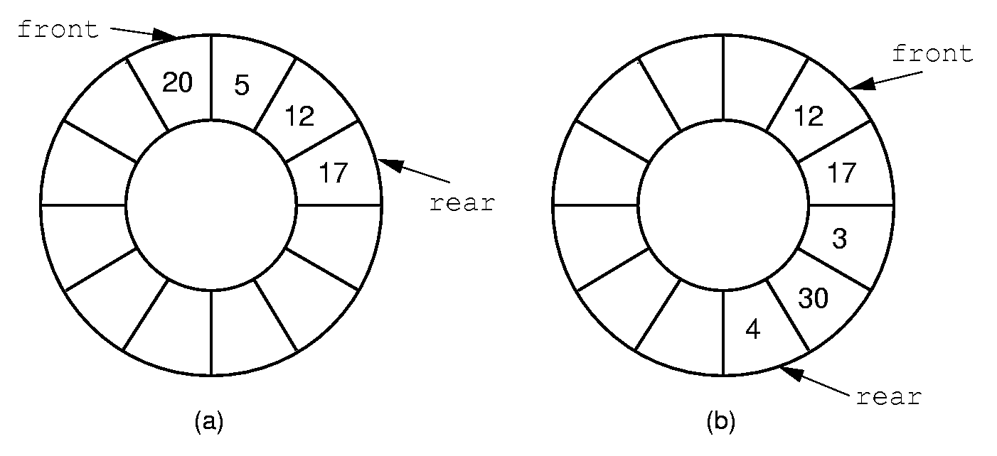
Queue Implementation

Slide 40
Queue Implementation

Slide 41
Contents of IntQueue.h 1 // Specification file for the IntQueue class 2 #ifndef INTQUEUE_H 3 #define INTQUEUE_H 4 5 class IntQueue 6 { 7 private: 8 int *queueArray; // Points to the queue array 9 int queueSize; // The queue size 10 int front; // Subscript of the queue front 11 int rear; // Subscript of the queue rear 12 int numItems; // Number of items in the queue

Slide 42
Contents of IntQueue.hpp (Continued)
13 public: 14 // Constructor 15 IntQueue(int); 16 17 // Copy constructor 18 IntQueue(const IntQueue &); 19 20 // Destructor 21 ~IntQueue(); 22 23 // Queue operations 24 void enqueue(int); 25 void dequeue(int &); 26 bool isEmpty() const; 27 bool isFull() const; 28 void clear(); 29 };

Slide 43
Constructors in IntQueue.cpp
IntQueue::IntQueue(int s)
{
queueArray = new int[s];
queueSize = s;
front = -1;
rear = -1;
numItems = 0;
}
IntQueue::IntQueue(const IntQueue &obj)
{
queueArray = new int[obj.queueSize];
queueSize = obj.queueSize;
front = obj.front;
rear = obj.rear;
numItems = obj.numItems;
for (int i = 0; i < obj.queueSize; ++i)
queueArray[i] = obj.queueArray[i];
}

Slide 44
Functions in IntQueue.cpp
void IntQueue::enqueue(int num)
{
if (isFull())
cout << "The queue is full.\n";
else
{
rear = (rear + 1) % queueSize;
queueArray[rear] = num;
numItems++;
}
}
void IntQueue::dequeue(int &num)
{
if (isEmpty())
cout << "The queue is empty.\n";
else
{
front = (front + 1) % queueSize;
num = queueArray[front];
numItems--;
}
}

Slide 45
Dynamic Queues
Like a stack, a queue can be implemented using a linked list
Allows dynamic sizing, avoids issue of shifting elements or wrapping indices
null
front
rear

Slide 46
Implementing a Queue
Programmers can program their own routines to implement queue operations
See the DynIntQue class in the book for an example of a dynamic queue
Can also use the implementation of queue and dequeue available in the STL

Slide 47
#ifndef DYNAMICQUEUE_H
#define DYNAMICQUEUE_H
#include <iostream>
using namespace std;
template <class T>
class DynamicQueue
{
private:
struct QueueNode
{
T value;
QueueNode *next;
};
QueueNode *front;
QueueNode *rear;
int numItems;

Slide 48
public:
DynamicQueue();
~DynamicQueue();
void enqueue(T);
void dequeue(T &);
bool isEmpty() const;
bool isFull() const;
void clear();
};
template <class T>
DynamicQueue<T>::DynamicQueue()
{
front = nullptr;
rear = nullptr;
numItems = 0;
}

Slide 49
template <class T>
void DynamicQueue<T>::enqueue(T item)
{
QueueNode *newNode = nullptr;
newNode = new QueueNode;
newNode->value = item;
newNode->next = nullptr;
// if (isEmpty())
{
front = newNode;
rear = newNode;
}
else
{
rear->next = newNode;
rear = newNode;
}
numItems++;
}

Slide 50
template <class T>
void DynamicQueue<T>::dequeue(T &item)
{
QueueNode *temp = nullptr;
if (isEmpty())
{
cout << "The queue is empty.\n";
}
else
{
item = front->value;
temp = front;
front = front->next;
delete temp;
numItems--;
}
}

Slide 51
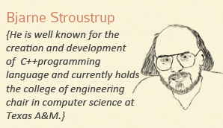
Alan Turing is credited with inventing the stack. Actually, no one invented the queue.

Slide 52
References
Slide contributions include:
Walter Savitch, Problem solving with C++ (9th Edition). Addison-Wesley Longman Publishing Co., Inc. Boston, MA, USA ©2015
Gaddis, Starting Out with C++: From Control Structures through Objects, (8th Ed.) , Addison-Wesley Longman Publishing Co., Inc. Boston, MA, USA ©2015
Bjarne Stroustrup, The C++ Programming Language, 3rd Edition, Addison-Wesley Longman Publishing Co., Inc. Boston, MA, USA ©2007
Herb Sutter, Andrei Alexandrescu, C++ coding standards : 101 rules, guidelines, and best practices, Copyright © 2005 Pearson Education, Inc.
Paul Deitel & Harvey Deitel, C++ How to Program, (7th Ed.) © 2010 by Pearson Education, Inc.
Upper Saddle River, New Jersey 07458
Scott Meyers, Effective Modern C++. Copyright © 2015 (O’Reilly) , 978-1-491-90399-5.
Andrew Koenig and Barbara E. Moo, Accelerated C++ Practical Programming by Example,
Addison-Wesley, 2000 ISBN 0-201-70353-X

Slide 53
References
Slide contributions include:
Frank M. Carrano. Data Abstraction & Problem Solving with C++ (5th Edition)
Addison-Wesley Longman Publishing Co., Inc. Boston, MA, USA ©2006
TutorialsPoint - http://www.tutorialspoint.com/cplusplus/
Cplusplus.com - http://www.cplusplus.com/doc/tutorial/

